Slide 1

Markov and State Space Data X: A Course on Data, Signals, and Systems
Data ^{X}
About Me:
Ikhlaq Sidhu Chief Scientist & Founding Director, Sutardja Center for Entrepreneurship & Technology IEOR Emerging Area Professor Award, UC Berkeley

Slide 2
Data Applications and State Space
Data Application
Input X
Output Y
Typically inferred from training from past X,Y
Data Application
With State
Input X
Output Y
Depends also on the last previous value of X

Slide 3
Next Word Predictor
Data Application
With State
A Word in
Text: Input X
Predict next word
In Text: Y
For state X, there will be a different likelihood for the next word
was
to
.1 .4. .5
.3
I
am
Transition
Probability
P =
.4 .2 .4
.5
from
.9 .1 0
.2
will

Slide 4
More Formally, what is a “State”
State space is a set
For example: S = { 0, 1, 2, 3 }
Typically States have a meaning, for example:
State 0 = Customer signed up for free (freemium) service
State 1= Customer upgrades to paid service ($10/mo)
State 2 = Customer upgrades to premium service ($20/mo)
State 3 = Customer stops paying for service

Slide 5
What is a State
State space is a set
For example: S = { 0, 1, 2, 3 }
State 0, 1, 3, 3 = Free, paid, premium, discontinues
Time is changing: n = 1, 2, 3, .. In discrete steps
There are a sequence of random variables that take on the State values
P=.9
P= .8
P=.9
P=1
0
1
2
3
P = .1
P = .2
P = .1

Slide 6
Markov basically means that the next State Depends only on the last one
For example: S = { 0, 1, 2, 3 }
n = number of months = 1, 2, 3 ..
State 0, 1, 3, 3 = Free, paid, premium, discontinues
X[n] is a random sequence, takes on x1, x2, x3…
So a sequence of X might be 0, 0, 0, 1, 1, 1, 2, 3, 3, 3, 0
P=.9
P= .8
P=.9
P=1
0
1
2
3
P = .1
P = .2
P = .1
Key Concept: It’s a Markov state only if the next state depend on the current state,
also known as a memoryless property

Slide 7
Same thing but in proper notation Discrete Time Markov Chain Definition
A stochastic process { X_{n} } is called a Markov chain if
Pr{ X_{n+1} = j | X₀ = k₀, . . . , X_{n-1} = k_{n-1}, X_{n} = i }
= Pr{ X_{n+1} = j | X_{n} = i } ← transition probabilities
for every i, j, k₀, . . . , k_{n-1} and for every n.
Discrete time means n ∈ N = { 0, 1, 2, . . . }.
The future behavior of the system depends only on the
current state i and not on any of the previous states.

Slide 8
Same thing but in proper notation Discrete Time Markov Chain Definition
Note: Academics love Markov because it has very nice properties.
It does not mean most things have Markov nature
With Data applications, some of those properties don’t really apply – but some also do.
A stochastic process { X_{n} } is called a Markov chain if
Pr{ X_{n+1} = j | X₀ = k₀, . . . , X_{n-1} = k_{n-1}, X_{n} = i }
= Pr{ X_{n+1} = j | X_{n} = i } ← transition probabilities
for every i, j, k₀, . . . , k_{n-1} and for every n.
Discrete time means n ∈ N = { 0, 1, 2, . . . }.
The future behavior of the system depends only on the
current state i and not on any of the previous states.

Slide 9
Continue Example
P=.9
P= .8
P=.9
P=1
0
1
2
3
P = .1
P = .2
P = .1
P{ X_{n+1} = 0| X_{n} = 0 } = .9
P{ X_{n+1} = 1| X_{n} = 0 } = .1
P{ X_{n+1} = 2| X_{n} = 0 } = 0
P{ X_{n+1} = 0| X_{n} = 0 } = 0

Slide 10
Continue to Example
P=.9
P= .8
P=.9
P=1
0
1
2
3
P = .1
P = .2
P = .1
P{ X_{n+1} = 0| X_{n} = 0 } = .9
P{ X_{n+1} = 1| X_{n} = 0 } = .1
P{ X_{n+1} = 2| X_{n} = 0 } = 0
P{ X_{n+1} = 0| X_{n} = 0 } = 0
Or in 1-step Transition matrix form
.9 .1 0 0 0 .8 .2 0
0 0 .9 .1
0 0 0 1
P =
P_{i,j} = prob to go from state i to state j

Slide 11
Transition Probabilities
For a customer starting at state 0, what is the probability that they will be in the other states after 2, 5, or 10 months?
Define Distribution of P^{(i)} (Xi) at step i at = [p1 p2 p3 p4]^{(i)}, ie p1 is prob of being in state 1
.9 .1 0 0 0 .8 .2 0
0 0 .9 .1
0 0 0 1
P(X1) =
P(X0)
X
=

Slide 12
Transition Probabilities
For a customer starting at state 0, what is the probability that they will be in the other states after 2, 5, or 10 months?
Define Distribution of P(Xi) at step I as [p1 p2 p3 p4], ie p1 is prob of being in state 1
.9 .1 0 0 0 .8 .2 0
0 0 .9 .1
0 0 0 1
P(X1) =
P(X0)
X
.9 .1 0 0 0 .8 .2 0
0 0 .9 .1
0 0 0 1
P (X1) =
[.9 .1 0 0]
=
[1 0 0 0 ]
X
=

Slide 13
Transition Probabilities
For a customer starting at state 0, what is the probability that they will be in the other states after 2, 5, or 10 months?
Define Distribution of P(Xi) at step I as [p1 p2 p3 p4], ie p1 is prob of being in state 1
.9 .1 0 0 0 .8 .2 0
0 0 .9 .1
0 0 0 1
[p1 p2 p3 p4]⁽¹⁾
=
[p1 p2 p3 p4]⁽⁰⁾
X
.9 .1 0 0 0 .8 .2 0
0 0 .9 .1
0 0 0 1
P⁽¹⁾ (X1) =
[.9 .1 0 0]
=
[1 0 0 0 ]⁽⁰⁾
X

Slide 14
n-Step Transition Probabilities
This idea generalizes to an arbitrary number of steps.
For n = 3: P⁽³⁾ = P⁽²⁾ P = P² P = P³
or more generally, P^{(n)} = P^{(m)} P^{(n-m)}
The ij th entry of this reduces to
p_{ij}^{(n)} = ∑ p_{ik}^{(m)} p_{kj}^{(n-m)} 1 ≤ m ≤ n−1
m
k =0
Chapman - Kolmogorov Equations
Interpretation:
RHS is the probability of going from i to k in m steps & then going from k to j in the remaining n − m steps, summed over all possible intermediate states k.

Slide 15
Brand Switching Example →
We approximate q_{i} (0) by dividing total customers using brand i in week 27 by total sample size of 500:
q(0) = (125/500, 230/500, 145/500) = (0.25, 0.46, 0.29)
To predict market shares for, say, week 29 (that is, 2 weeks into the future), we simply apply equation with n = 2:
q(2) = q(0)P⁽²⁾
= (0.327, 0.406, 0.267)
= expected market share from brands 1, 2, 3
Example from Internet, U of Texas

Slide 16
Steady-State Probabilities
Property 2: Let π = (π₁, π₂, . . . , π_{m}) is the m-dimensional row vector of steady-state (unconditional) probabilities for the state space S = {1,…,m}. To find steady-state probabilities, solve linear system:
π = πP, Σ_{j=1,m} π_{j} = 1, π_{j} ≥ 0, j = 1,…,m
Brand switching example:
π₁ + π₂ + π₂ = 1, π₁ ≥ 0, π₂ ≥ 0, π₃ ≥ 0

Slide 17
Yes, steady state probably is easy to calculate
Small matter: Ergodic: Aperiodic and and allows the attainment of any future state
π₁ = 0.90π₁ + 0.02π₂ + 0.20π₃
π₂ = 0.07π₁ + 0.82π₂ + 0.12π₃
π₃ = 0.03π₁ + 0.16π₂ + 0.68π₃
π₁ + π₂ + π₃ = 1
π₁ ≥ 0, π₂ ≥ 0, π₃ ≥ 0
Total of 4 equations,
3 unknowns
Discard 3rd equation and solve the remaining system to get :
π₁ = 0.474, π₂ = 0.321, π₃ = 0.205

Slide 18
Steady State
Steady-State Probabilities
Again, this is one of the coolest things you can do with Markov Chains:
Ie calculate the steady state probability
π = πP
Unfortunately, this is not as commonly used from a data (empirical) view
More often the transition matrix is collected in training as in the Next Word predictor case
Property 2: Let π = (π₁, π₂, . . . , π_{m}) is the m-dimensional row vector of steady-state (unconditional) probabilities for the state space S = {1,…,m}. To find steady-state probabilities, solve linear system:
π = πP, Σ_{j=1,m} π_{j} = 1, π_{j} ≥ 0, j = 1,…,m
Brand switching example:
π₁ + π₂ + π₂ = 1, π₁ ≥ 0, π₂ ≥ 0, π₃ ≥ 0

Slide 19
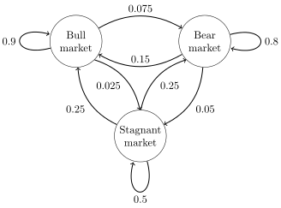
Probability of Being in Particular State and Balancing Flow
You can start with initial condition: p0
N step distribution = pn = p0 P^{n}
Steady State: π = πP
And also: use balance equations:
e.g. cut anywhere into two chains: p(bear) x (.05 + 0.15) =
p(stagnant) x .25 +
P(bull) x 0.75

Slide 20
These models all have problems because of lack of feedback
https://www.youtube.com/watch?v=g0TaYhjpOfo

Slide 21
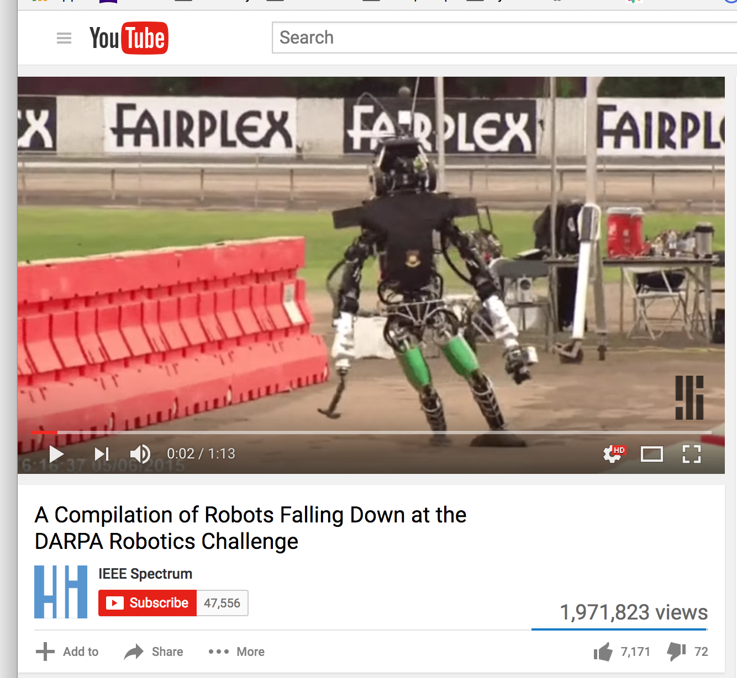
These models all have problems because of lack of feedback
https://www.youtube.com/watch?v=g0TaYhjpOfo

Slide 22
Markov State is being Combined with ML to take different actions depending on the state/situation

Slide 23
Markov State is being Combined with ML to take different actions depending on the state/situation
The goal here is not to introduce reinforcement leaning, but instead to introduce the idea that your project could track a “state”
and use a different ML approach to depending on the state.

Slide 24
End of Section

Slide 25
Markov State is being Combined with ML to take different actions depending on the state/situation

Slide 28
Training Models from Real Life

Slide 29
Problem Case

Slide 30
Balancing Flow

Slide 31
Famous Processes

Slide 32
Making Models

Slide 33
A Text Processing Example

